Slide 1
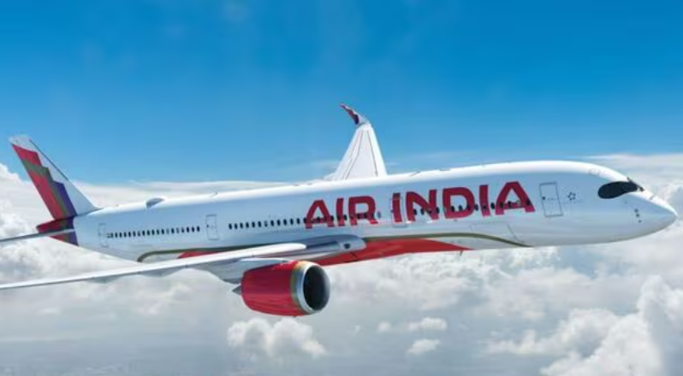

Airfare Insights
Analyzing Indian Flight Prices and Patterns
Presented By:
K S Roshini

Slide 2



PROBLEM STATEMENT
“ What drives flight fare variation in India?”
Airfare pricing in India is influenced by numerous factors including the airlines, number of stops, journey duration, timing, and route.
This project investigates which flight features significantly affect ticket prices to help both customers and airline companies make informed decisions.

Slide 3
OBJECTIVE
Goal:
To uncover the factors influencing flight fare variation in India through data exploration, statistical analysis, and visual insights
This project challenges to uncover trends in airfare and how different flight attributes impact pricing.
To analyze pricing patterns across different Indian domestic airlines and routes.
To apply statistical tests to validate significant influences on pricing.
To provide actionable insights for customers to find better fares and for airlines to optimize pricing strategies.

Slide 4

Download Dataset
Data cleaning $ preprocessing
Exploratory Data Analysis
Statistical and SQL Analysis
Visualizations
Key Findings

Slide 5
DATASET OVERVIEW
The dataset includes key information about flights and airfares, such as:
Airlines - Name of the airline operating the flight
Flight Route - Source and destination cities
Departure & Arrival Times - Scheduled departure and arrival timings
Duration & Stops - Total travel time and number of stops between source and destination
Price - Final ticket price for the flight

Slide 6
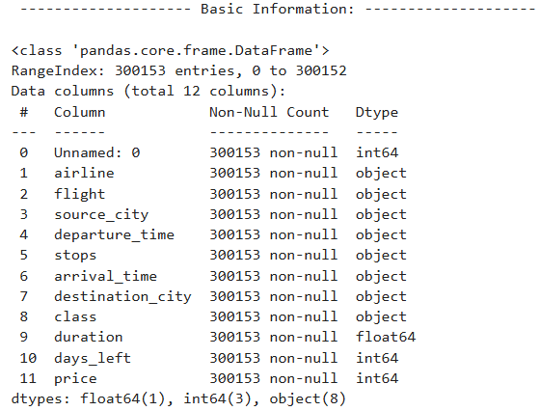
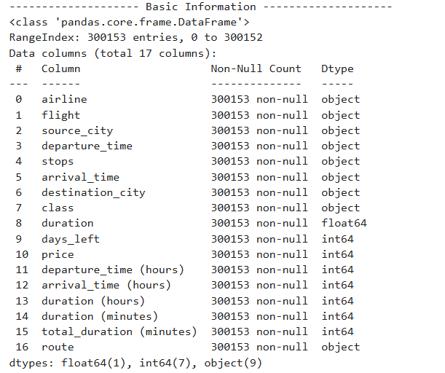
1. DATA CLEANING AND PREPROCESSING

Slide 7
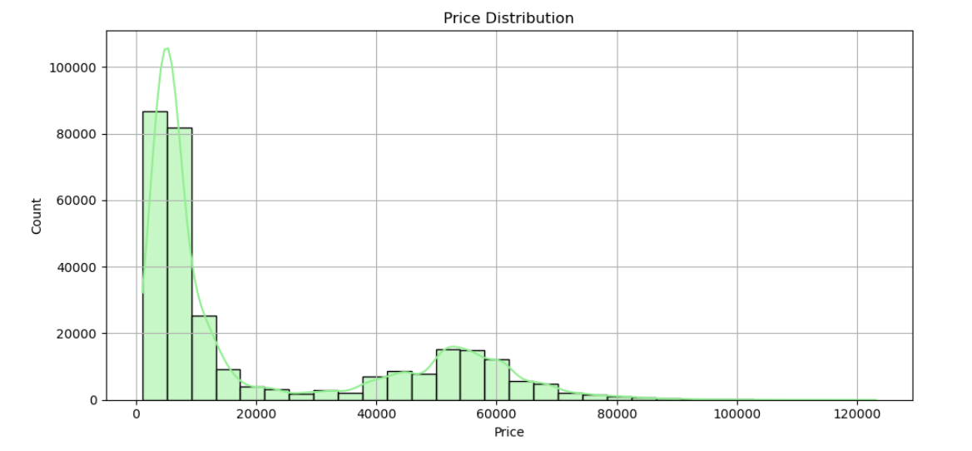
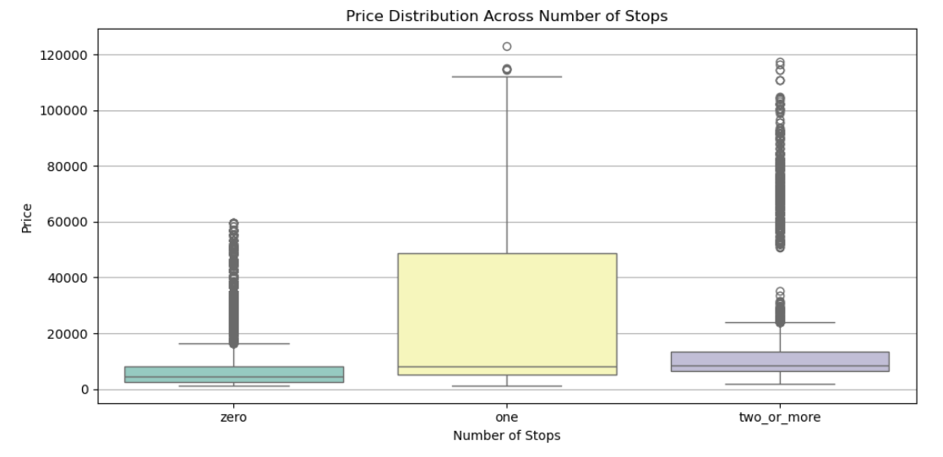
2. EDA INSIGHTS

Slide 8
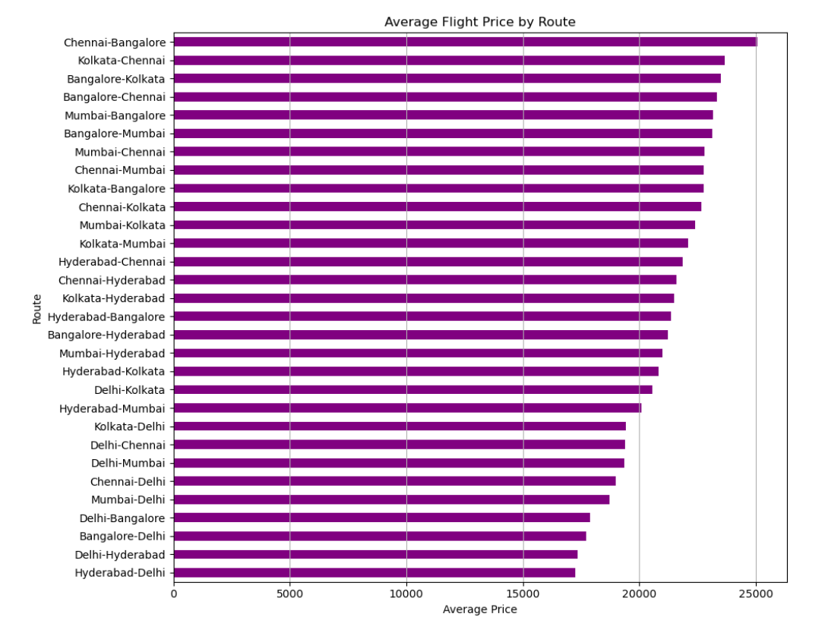
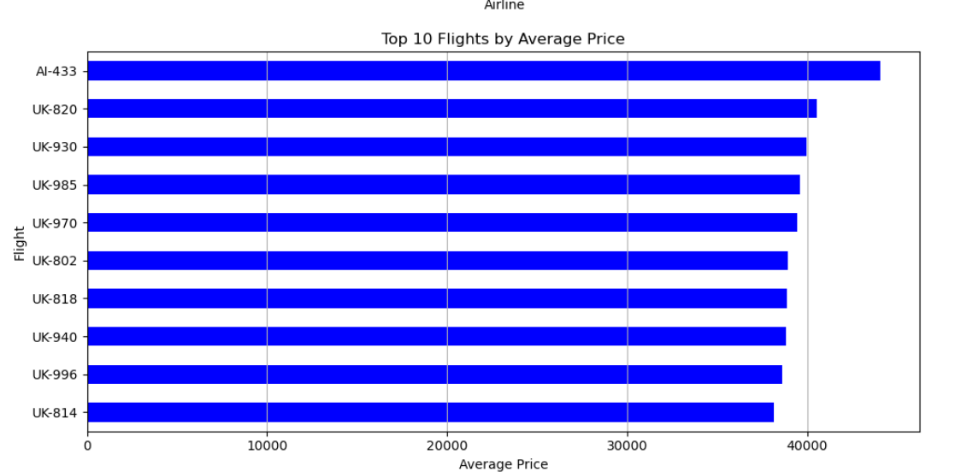
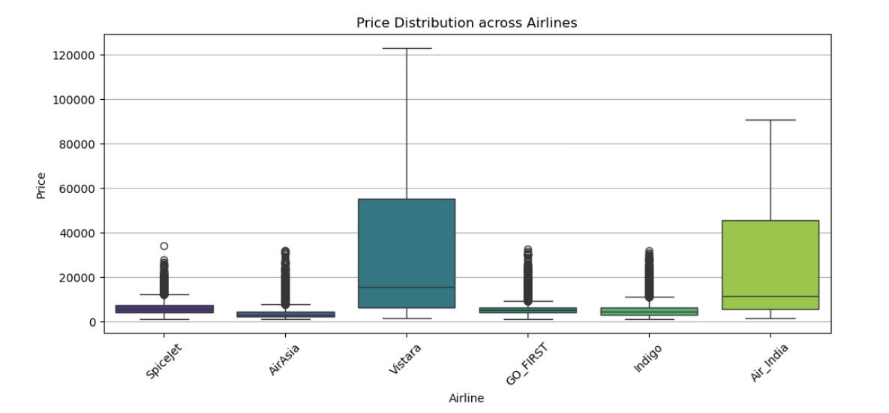

Slide 9
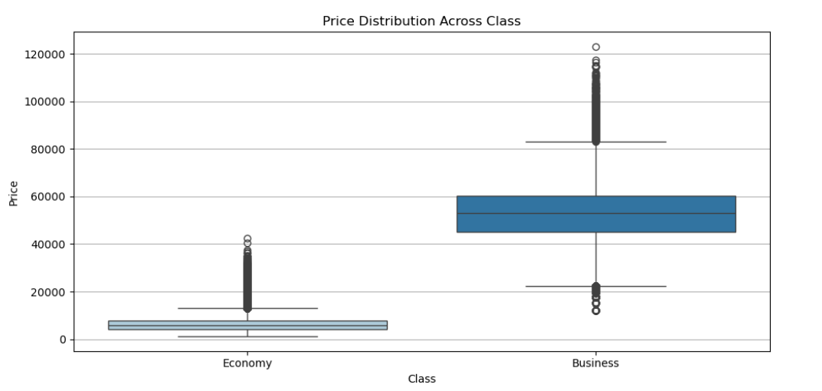
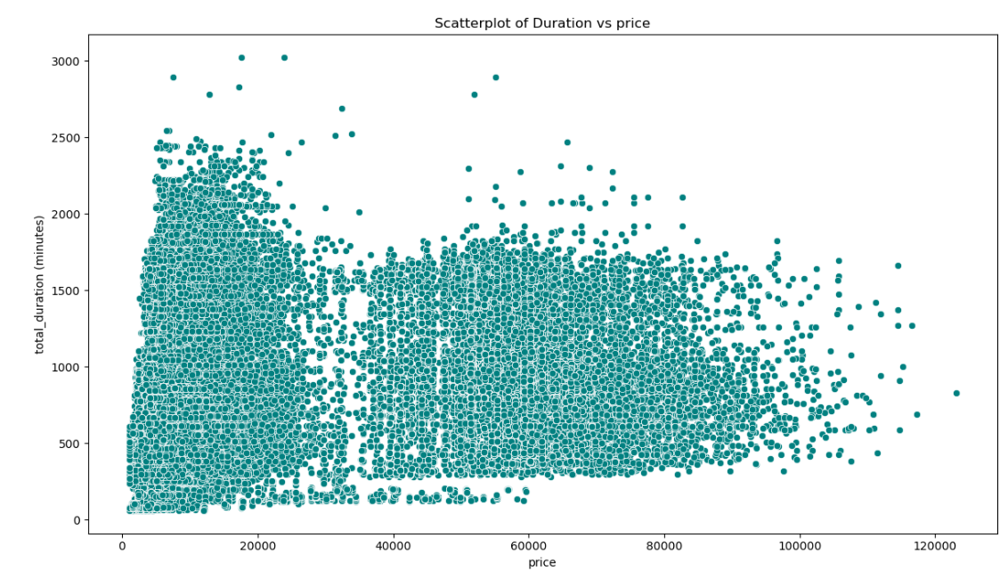

Slide 10
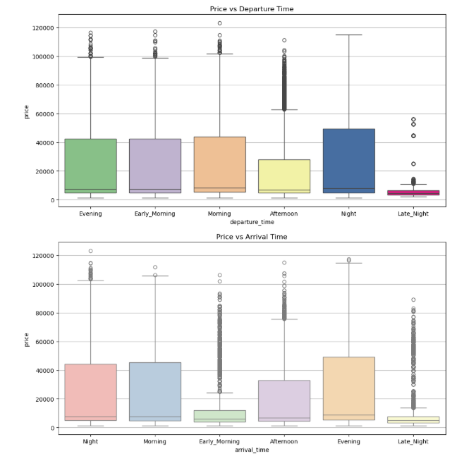
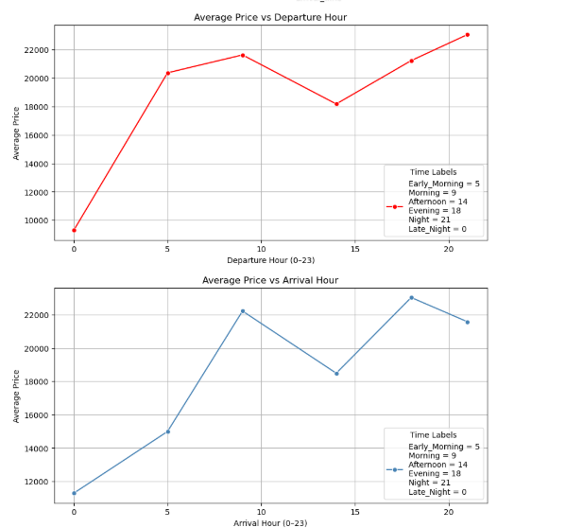

Slide 11

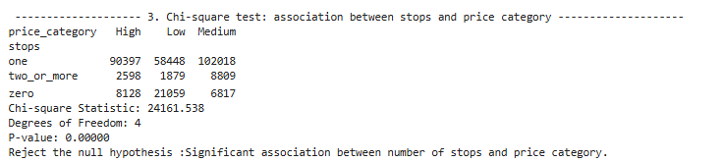
3.STATISTICAL ANALYSIS

Slide 12
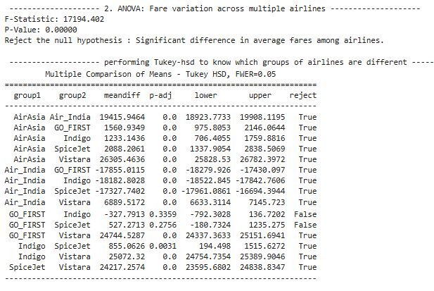

Slide 13
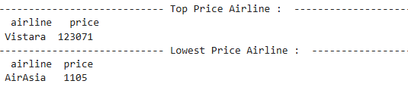
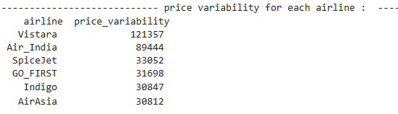
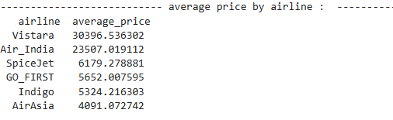
4.SQL ANALYSIS

Slide 14
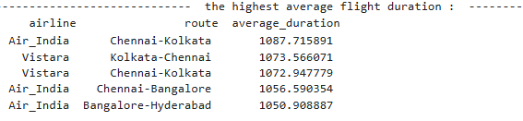
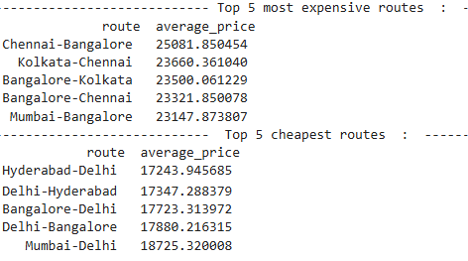
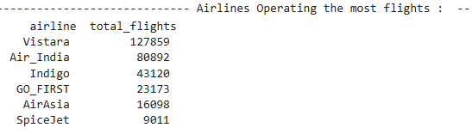
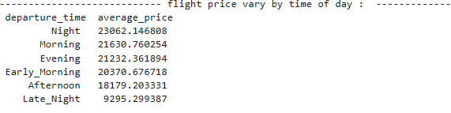

Slide 15
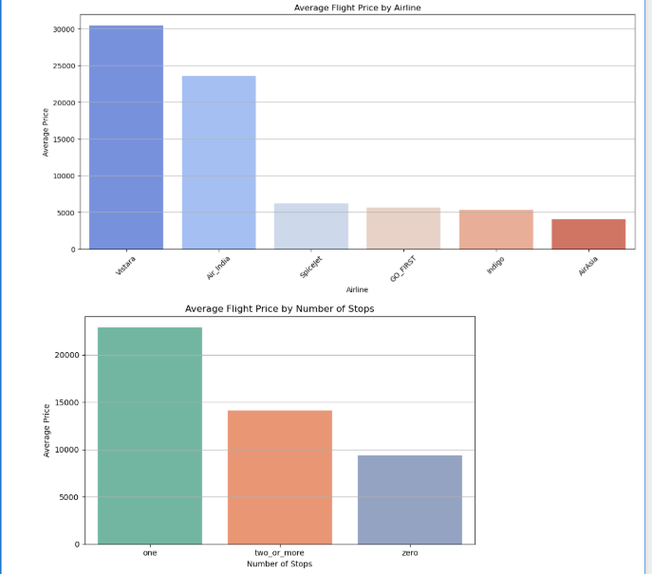
5.VISUALIZATIONS

Slide 16
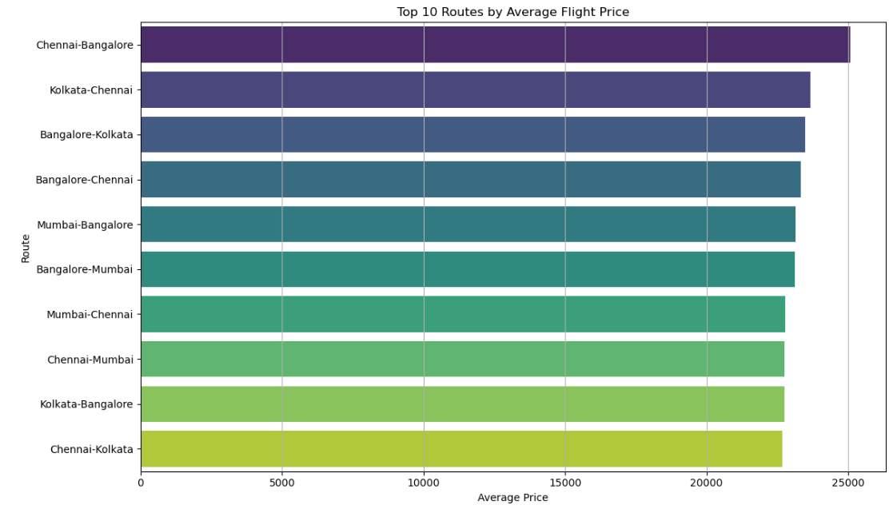

Slide 17
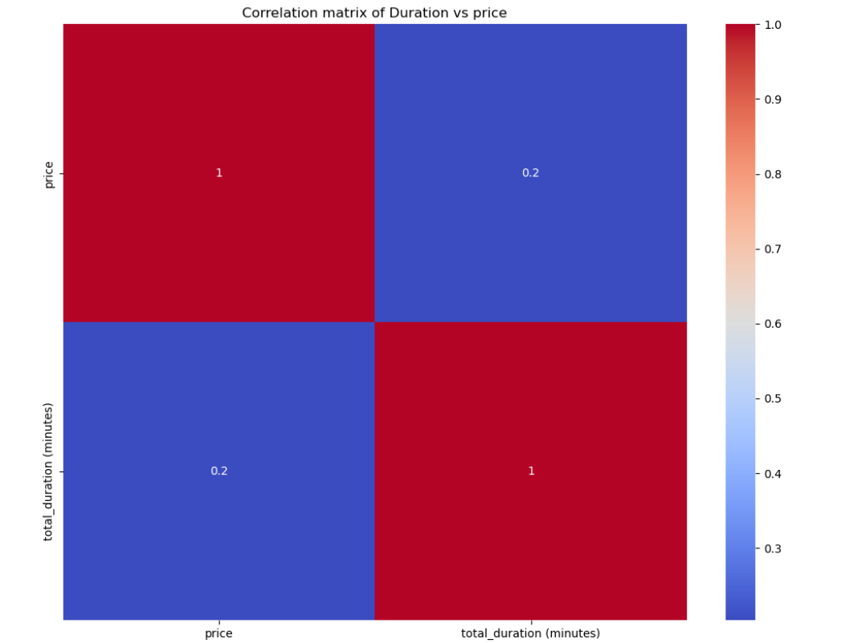
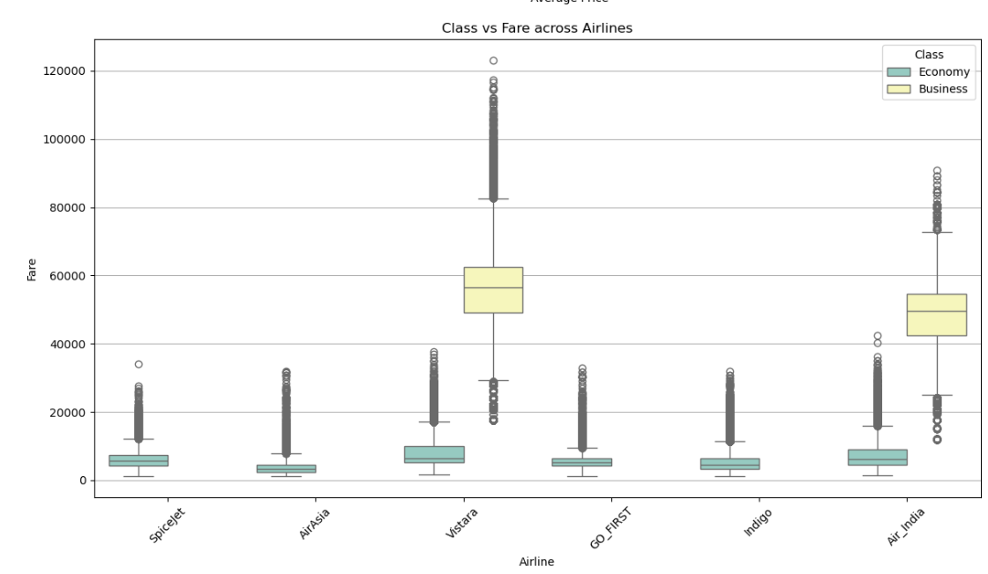

Slide 18
KEY FINDINGS
Business class fares command a significant premium over economy class.
Route is the strongest price determinant, especially flights between southern and eastern cities, which tend to be the most expensive.
Vistara and Air India are positioned as premium carriers with consistently higher fares.
AirAsia and Indigo function as budget airlines, offering lower average fares.
Night departures and arrivals are priced higher, reflecting peak demand.
Late-night flights tend to be the cheapest, likely due to lower demand.
One-stop flights are more expensive than non-stop flights, to typical cost-saving expectations.
Flight duration and price show only a weak correlation, indicating that time is not a major price driver.

Slide 19
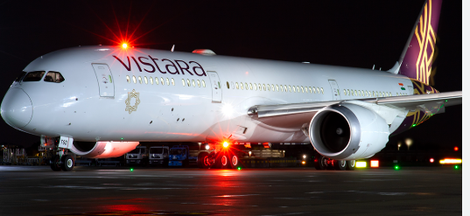
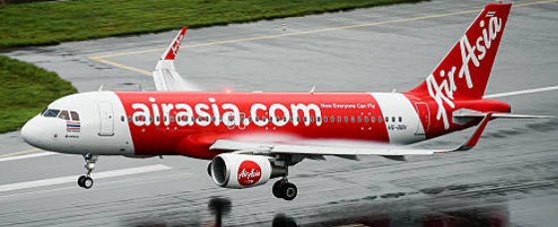
CONCLUSION
Airline fares are influenced more by route, class, and airline brand than by duration or number of stops.
One-stop flights are surprisingly more expensive than non-stop, likely due to strategic pricing and demand.
Premium airlines like Vistara and Air India consistently charge higher fares across routes.
Budget carriers like Indigo and AirAsia serve the price-sensitive market with lower average fares.
Departure time matters — peak night hours are expensive, while late-night flights are cheaper.
Flight duration has only a weak correlation with fare, suggesting pricing isn’t heavily time-based.

Slide 20
RECOMMENDATIONS
Optimize Route Pricing
Focus on premium routes with higher demand and perceived value. Enhance customer experience and justify pricing on expensive routes.
Stopover Pricing Strategy
Re-evaluate pricing for one-stop/connecting flights. Introduce targeted discounts to make them more competitive.
Time-of-Day Strategy
Promote off-peak flights (late night/afternoon) to price-sensitive travelers. Upsell peak-time flights (evening/night) to maximize revenue. Implement time-based offers to improve load balancing.

Slide 21
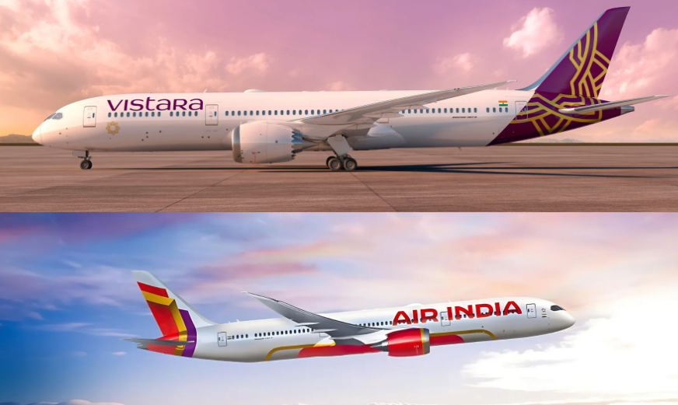
THANK YOU

